Slide 1


AVEGA BROS. INTEGRATED SHIPPING CORP.
TRAINEES ATTENDANCE
MONITORING SYSTEM
SPECIAL PROJECT BY:
John Louie T. Gastardo
Rhealyn O. Arnoco
Zyrah M. Pepito
Bebelyn P. Rodrigo
Marichu P. Arriesgado
Charity N. Salgarino
BACHELOR OF INDUSTRIAL TECHNOLOGY MAJOR IN COMPUTER TECHNOLOGY

Slide 2
SCOPE
The study focuses on attendance management of the OJTs Attendance and Bi-weekly Report project.
Create attendance system for the team project using Agile methods.
Attendance management employs user-friendly access for OJT advisers and students.
Make sure the system can adjust to any changes in schedules.
Share a weekly log of what we've done, skills learned, and challenges.

Slide 3
Methodology
We're using Agile method to improve the OJTs Attendance and Bi-weekly Report project.
Scrum is an agile method that's iterative and adaptable. It's designed to provide value reliably in all projects, ensuring transparency, communication, collaboration, and sustainable progress.
Sprint planning meeting
Daily stand-up meeting
Sprint Review
PHP, MySQL, JavaScript and Boostrap 5.0 are programming languages use for web development.

Slide 4
USERS PANEL
User’s Manual

Slide 5
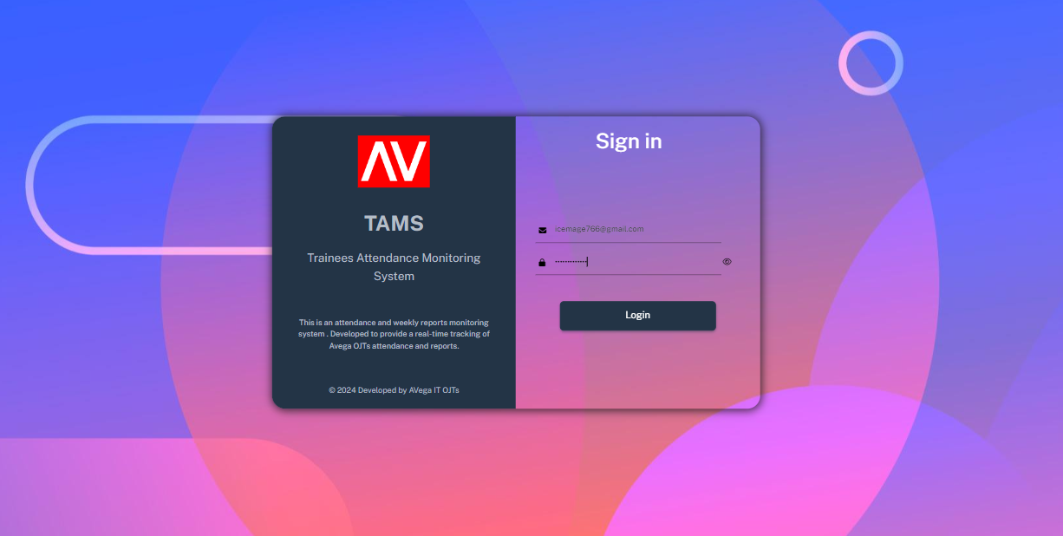
LOGIN
Go to the Attendance Monitoring website.
http://localhost/av_ojt/project101/LOGIN/index.php
Enter your email address and password in the respective fields.
Click the Login button.
Click here to Login

Slide 6
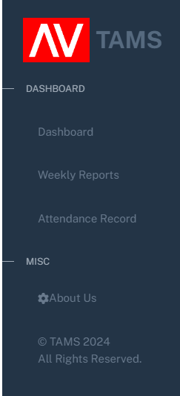
TRAINEE NAVIGATION
Provides an overview of the current progress.
Manages your weekly reports and submissions.
Tracks your attendance and time spent working.
Developer credits.

Slide 7
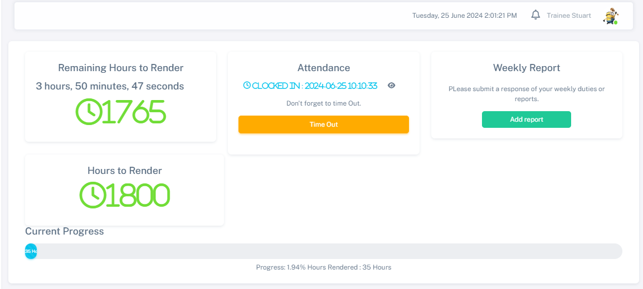
USER DASHBOARD
Click the notification bell if you have notifications.
Click the ‘Time In' button to start your timesheet and click the ‘Time Out’ to end your timesheet.
Shows the remaining hours you render.
Shows the logged user
Shows the total hours you need to render.
Shows the current date and time.
Shows your time progress and the total hours you rendered.
Click add report, to add new report.

Slide 8
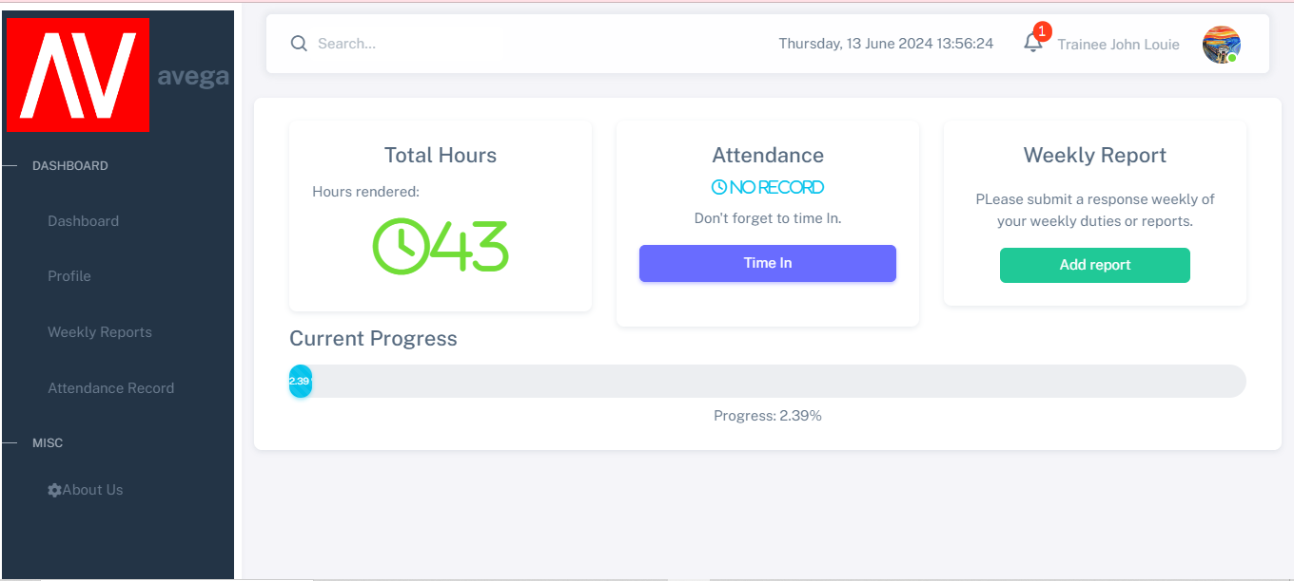
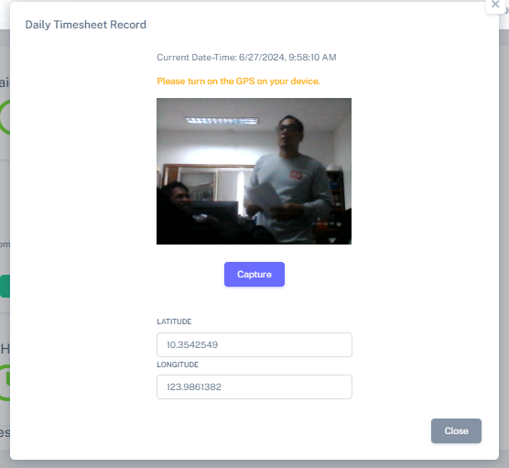
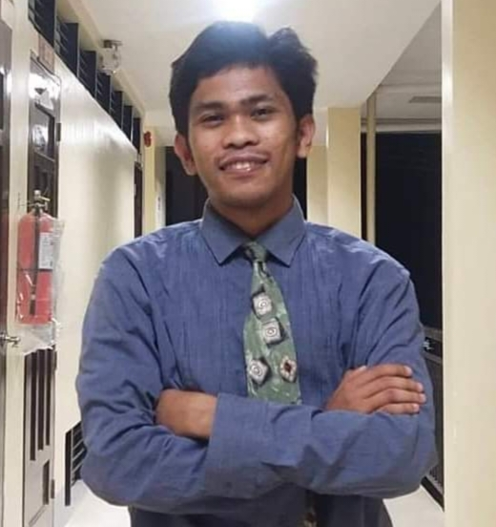
TIME IN
1. Turn on location in your device.
Click Time in button to start your shift.
1
2
Click here to Time in
2. Click capture button to take picture of your face , along with location data.
Click here to capture photo

Slide 9
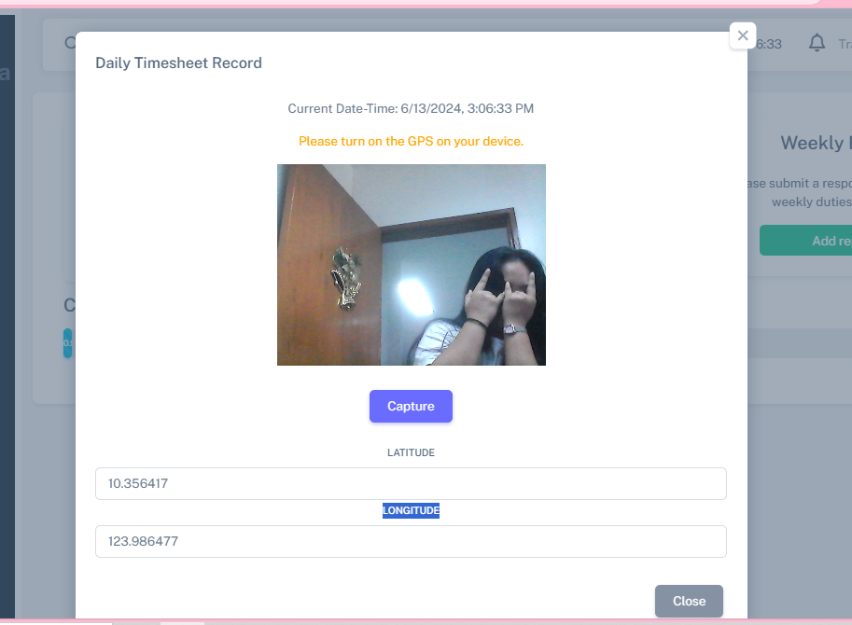
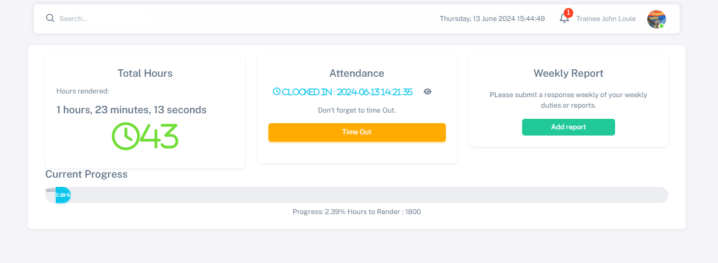
TIME OUT
1. Turn on location in your device.
Click Time out button to end your shift.
1
2
Click here to Time out
2. Click capture button to take picture of your face , along with location data.
Click here to capture photo
Note: You need a minimum of 2 hours to time out

Slide 10
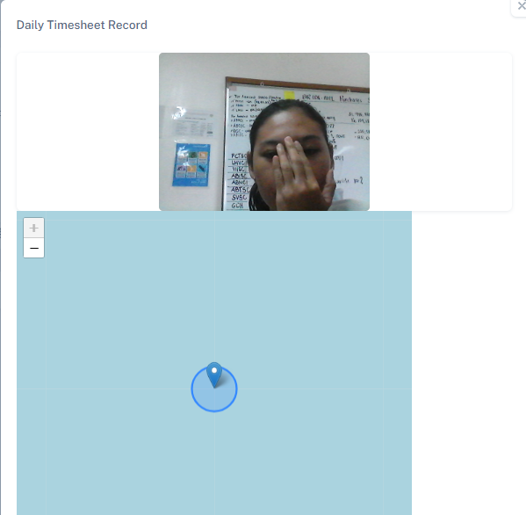
After you click, your photo will appear.
To view the snapshot of your clock in or clock out, click the eye icon.

Slide 11
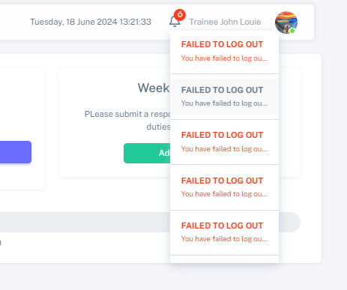
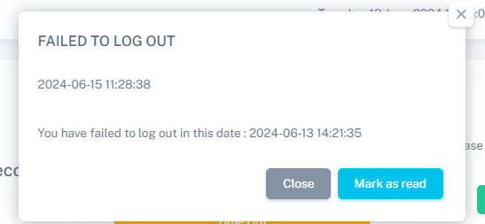
NOTIFICATION FOR FAILED LOG OUT
You will receive a notification if you forget to clock out.
Click mark as read to prevent it from appearing again.
Click close to ignore the message.
NOTE: REACH OUT IMMEDIATELY TO YOUR MANAGER IF YOU FORGOT TO LOG OUT.

Slide 12
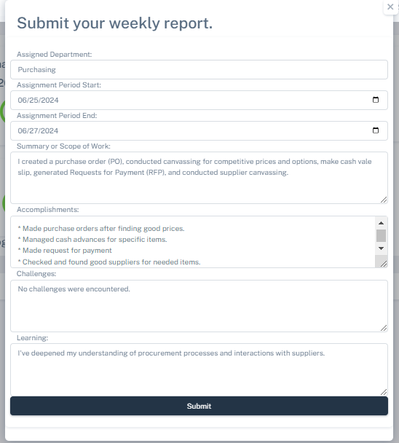
WEEKLY REPORT
Fill up all the required fields.
1
2
Click here to submit your report
Click here to add report
1. Click add report button to input
your weekly report.
2. Click submit button after completing the form

Slide 13
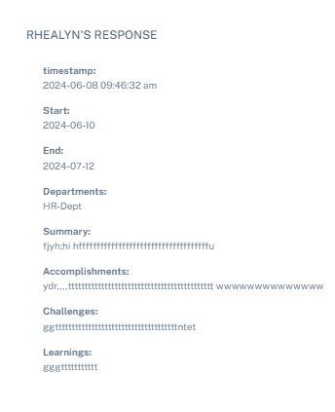
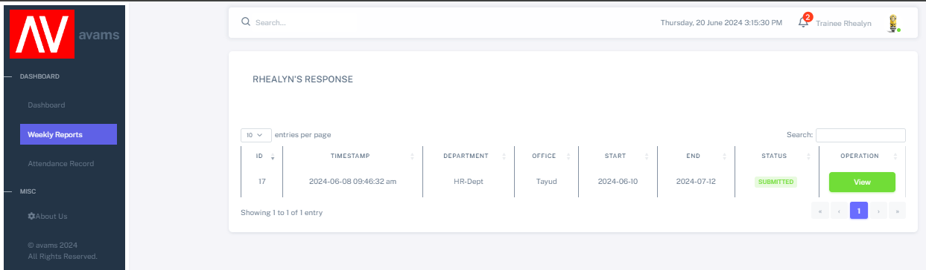
WEEKLY REPORT
3
1
2
1. Click Weekly Report button to view
your submitted reports.
2. Click the View button to view
your response.

Slide 14
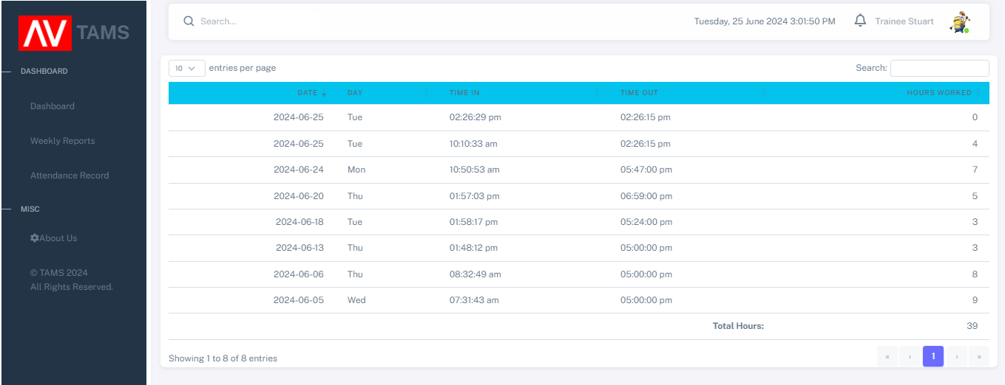
ATTENDANCE RECORD
Click Attendance Report button to view your attendance records.

Slide 15
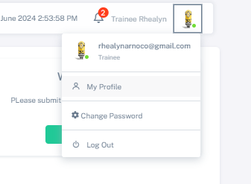
USER ACCOUNT
Displays your email and account type.
To view and edit your profile details.
To update your password.
To securely exit your account.

Slide 16
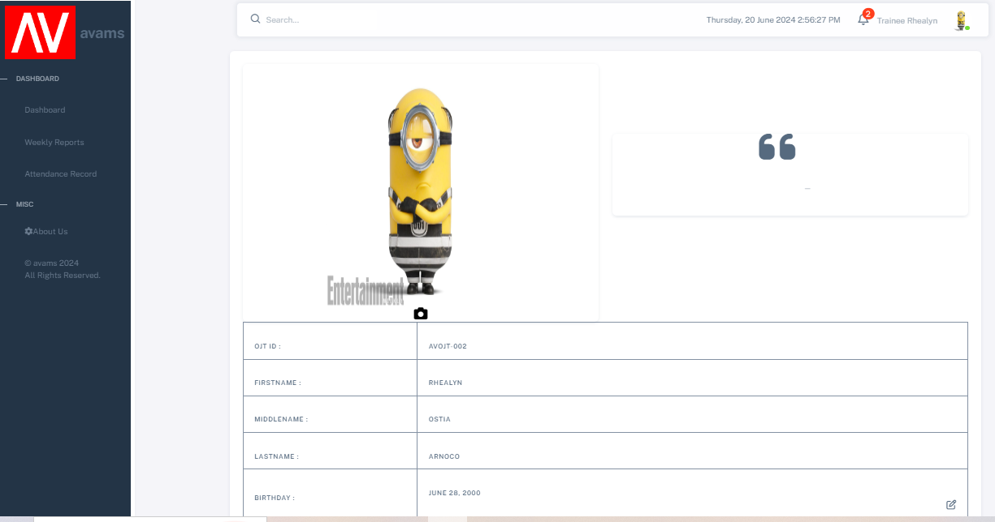
USER PROFILE
1. Click Profile picture.
1
3
2
2. Click My Profile to see personal details.

Slide 17
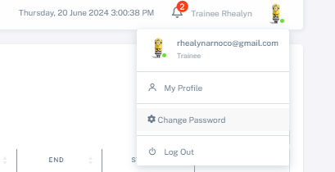
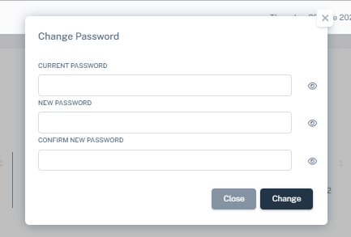
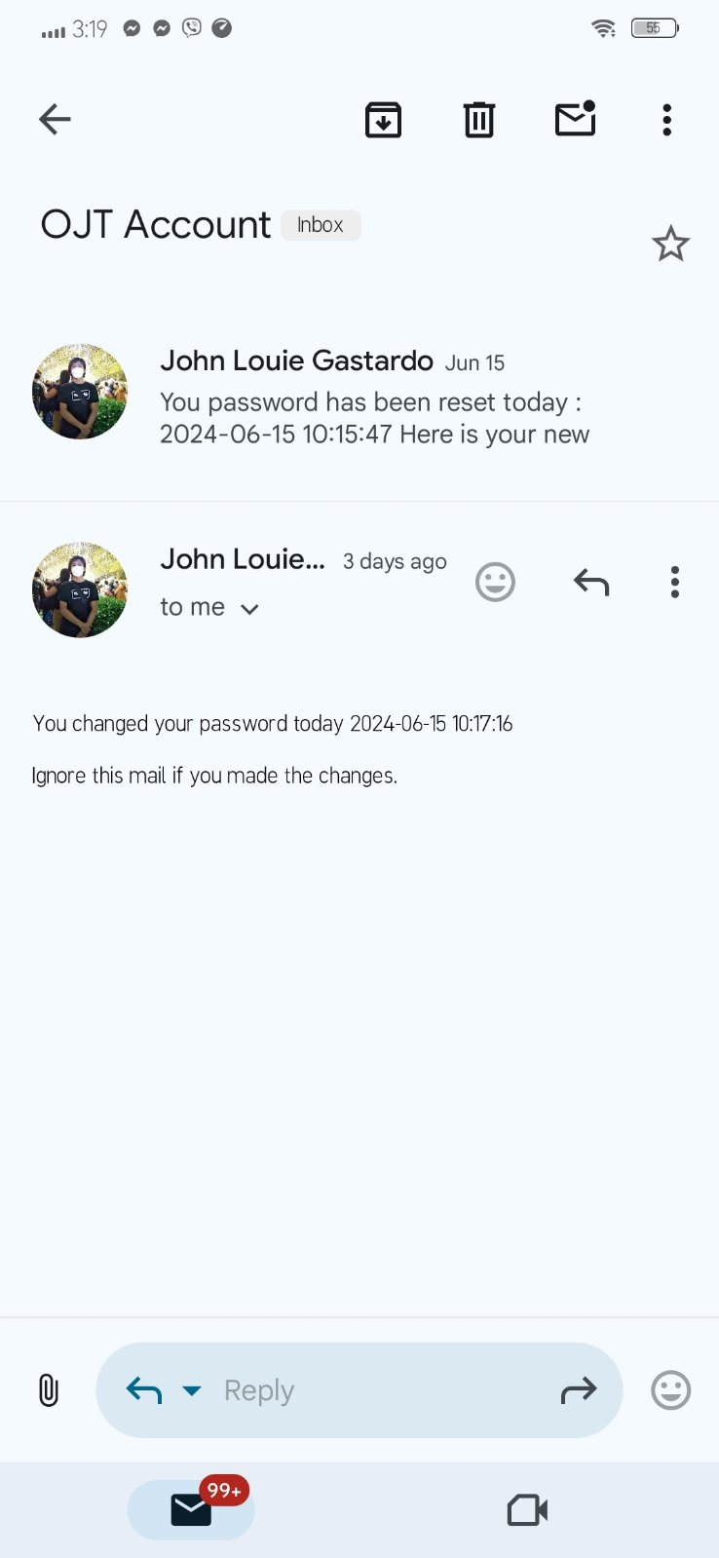
CHANGE PASSWORD
1. Click Change Password if you want to change your password
2. Enter your current password, new password, and confirm password and click change button.
3. You will receive an email after changing your password
1
2
3

Slide 18
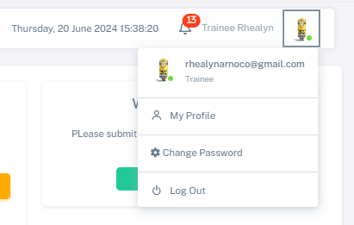
LOG OUT
1
2
1. Click Log Out if you want to log out your account.
2. Back to Log In page.

Slide 19
ADMIN PANEL
User’s Manual

Slide 20
LOGIN
Go to the Attendance Monitoring website.
http://localhost/av_ojt/project101/LOGIN/index.php
Enter your email address and password in the respective fields.
Click the “Login” button.
Click here to Login

Slide 21
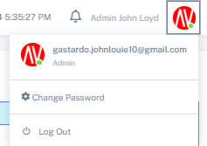
ADMIN ACCOUNT
Displays your email and account type.
To update your password.
To securely exit your account.

Slide 22
CHANGE PASSWORD
1. Click Change Password if you want to change your password
2. Enter your current password, new password, and confirm password and click change button.
3. You will receive an email after changing your password
1
2
3

Slide 23
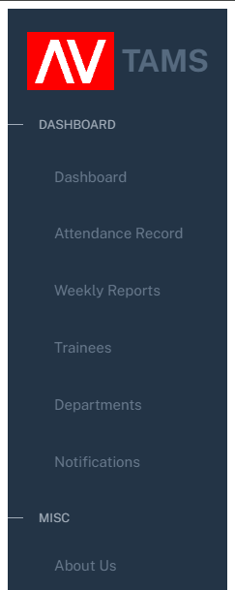
ADMIN NAVIGATION
Display the number of admin, manager and trainees. Manage user accounts.
Monitor trainees attendance records.
Monitor the trainees weekly reports.
Manage trainees profiles.
Manage departments.
Send notification alert to the users.
Developer credits.
Developer credits.

Slide 24
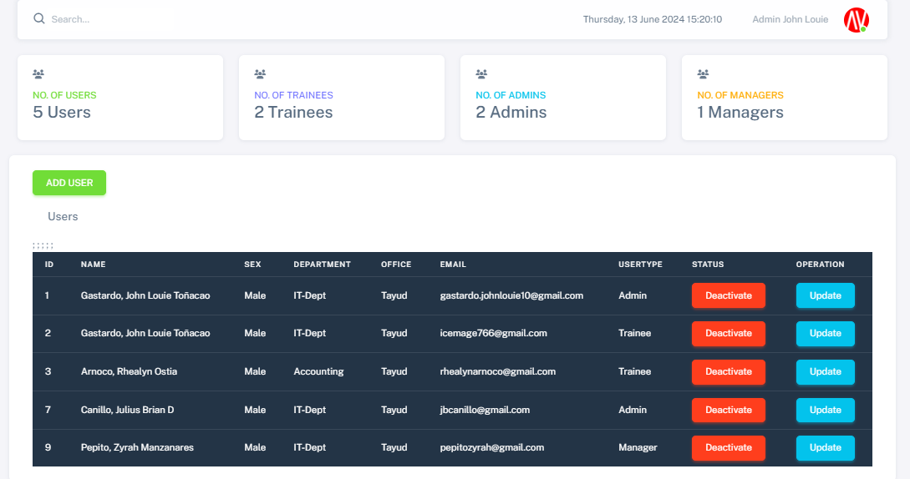
DASHBOARD
Display the total numbers of admin.
Indicate the total number of manager
Shows the total numbers of users.
Indicate the total numbers of trainees

Slide 25
ADD USER
1. Click here to add new user.
1

Slide 26
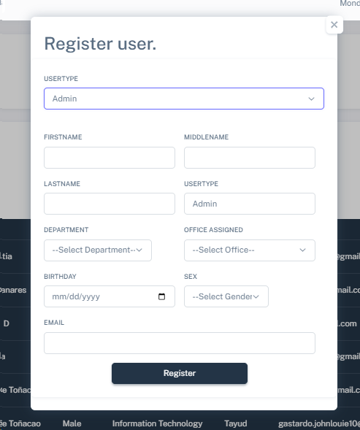
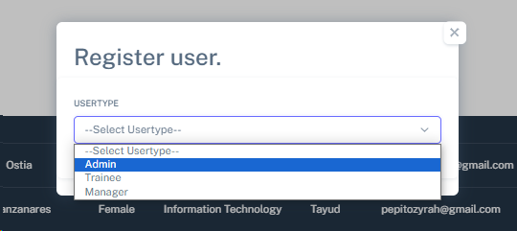
2. Select a department.
3. Fill in all the required fields.
3
2
4. Click the register button to proceed.
4
NOTE: IF USER TYPE IS TRAINEE, FILL OUT THE TRAINEE INFORMATION SHEET.

Slide 27
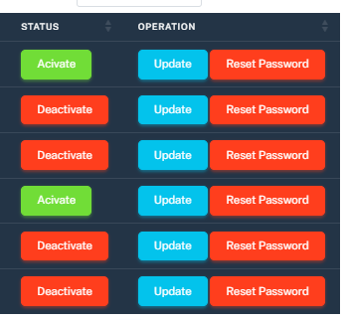
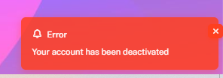
ACTIVATE AND DEACTIVATE ACCOUNTS
1
1.Click status to Activate or Deactivate user
2
2. Once the account is deactivated the user can’t login.

Slide 28
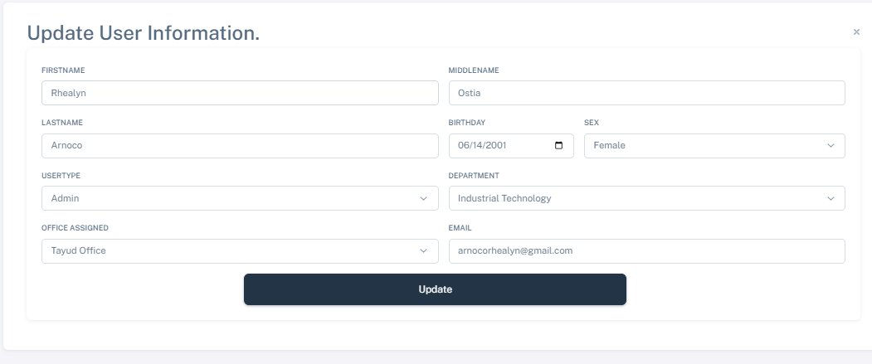
UPDATE USERS INFORMATION
2
2. Edit users information.
3
1
1. Click update button to update users information
3. Click update button.

Slide 29
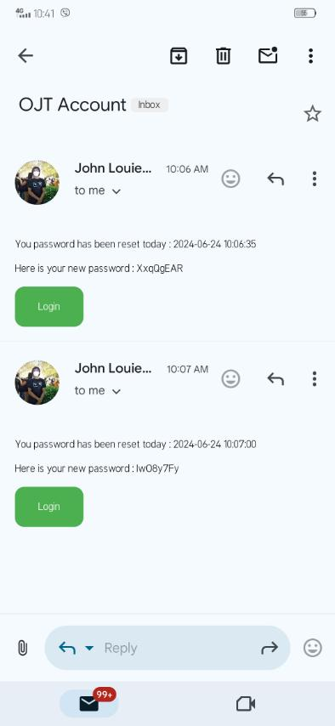
RESET PASSWORD
1.Click reset password button.
1
2
2.The user will receive an email once the password is reset.

Slide 30
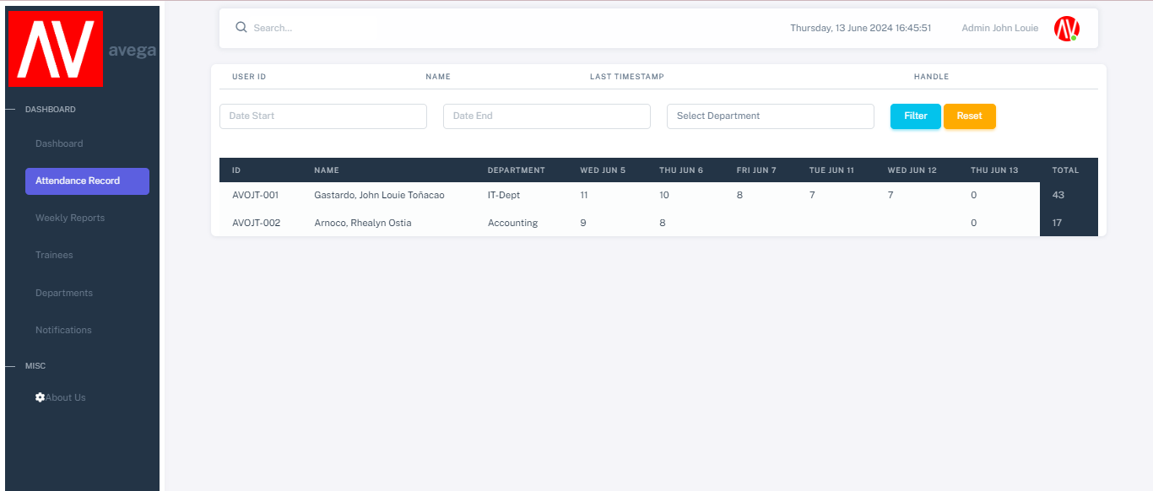
ATTENDANCE RECORD
2.Select filter to choose specific date and department.
1.Click attendance record to access details of trainee attendance.
1
2
If you wish to reset, click the reset button.

Slide 31
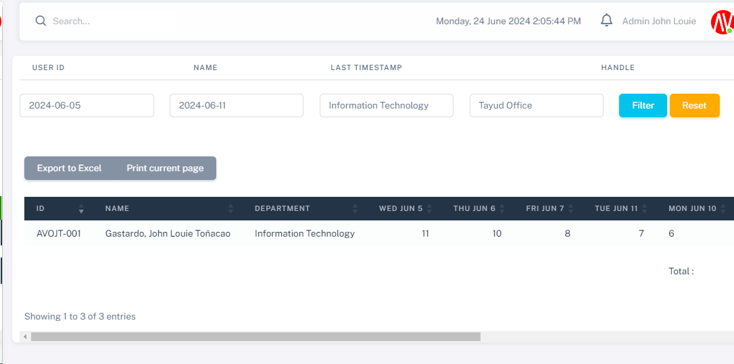
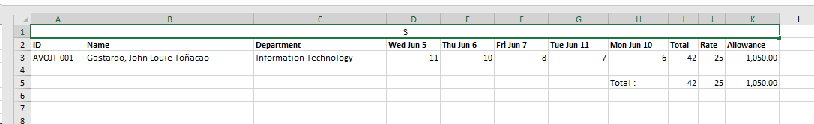
3.Select export to excel to generate the attendance report in excel format.
3
Here’s an example when exporting to Excel.

Slide 32
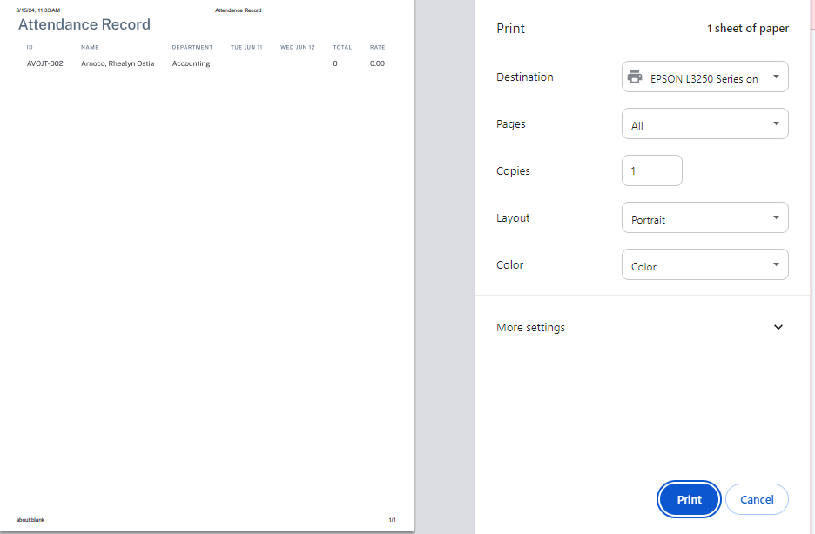
4.Select print current page to generate a printable report.
4
Here is an example you will see when you print the current page.

Slide 33
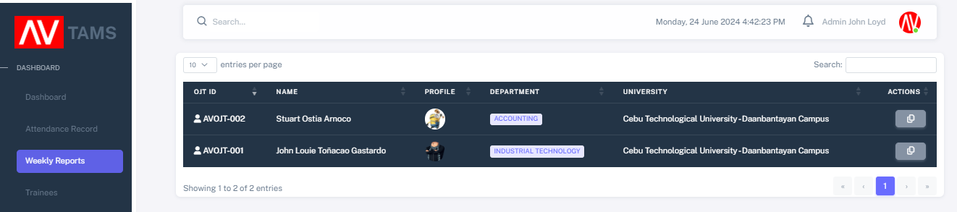
WEEKLY REPORTS
1. Click weekly reports button to view trainees responses.
2
1
2. Click view button to view the trainees responses

Slide 34
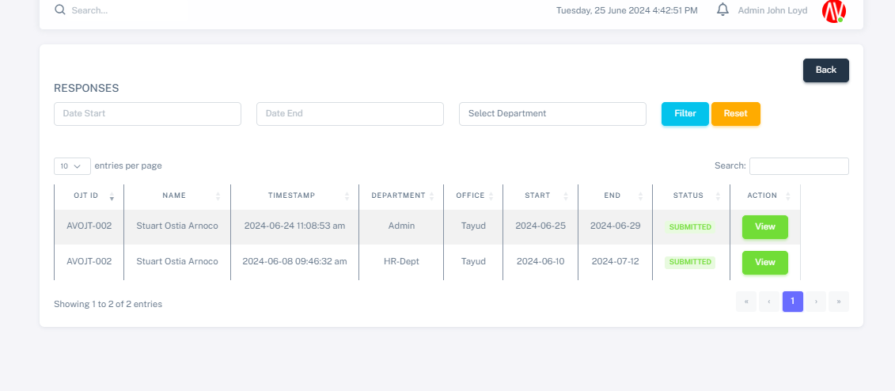
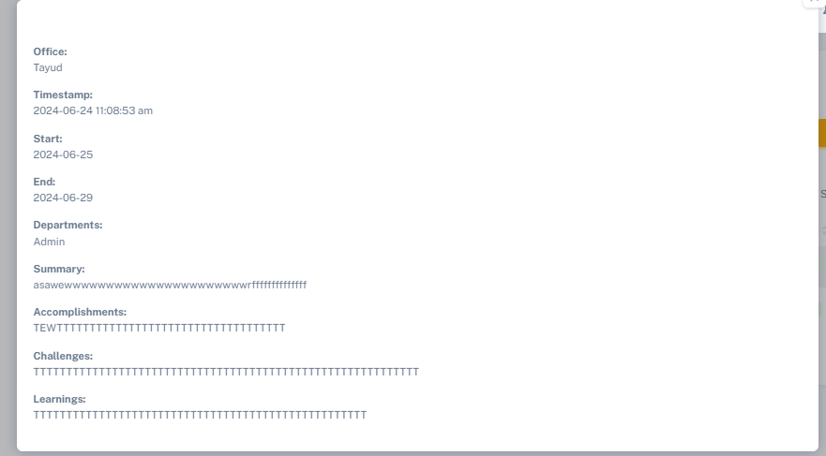
3. Click view button to view trainees response.
3
Trainee’s Response

Slide 35
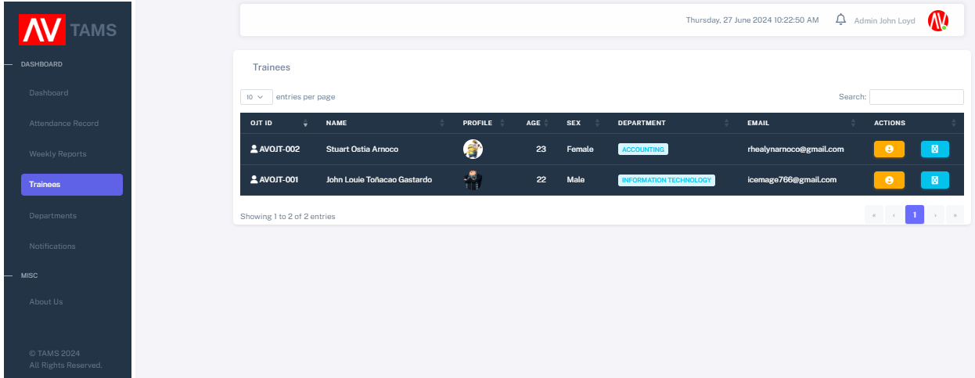
TRAINEES PROFILE
1.Click Trainees to manage and track progress.
2.Click here to view profile records
2
1

Slide 36
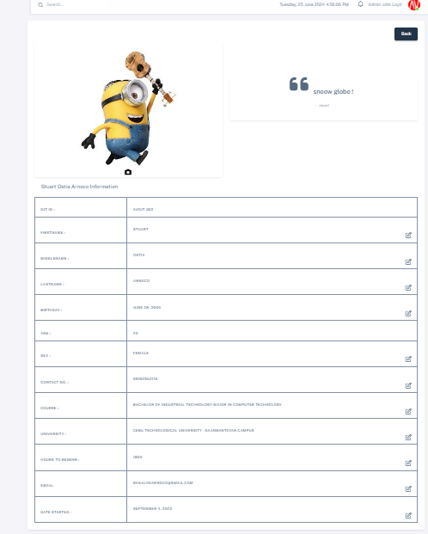
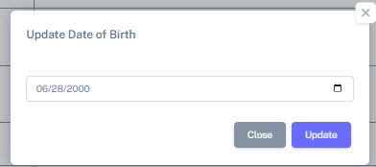
3. Profile Information
4.Select an information and click edit button.
3
4
5
5. Click update button to update the information.

Slide 37
TRAINEES ATTENDANCE
2.Click here to view attendance records
2
1
1.Click Trainees to manage and track progress

Slide 38
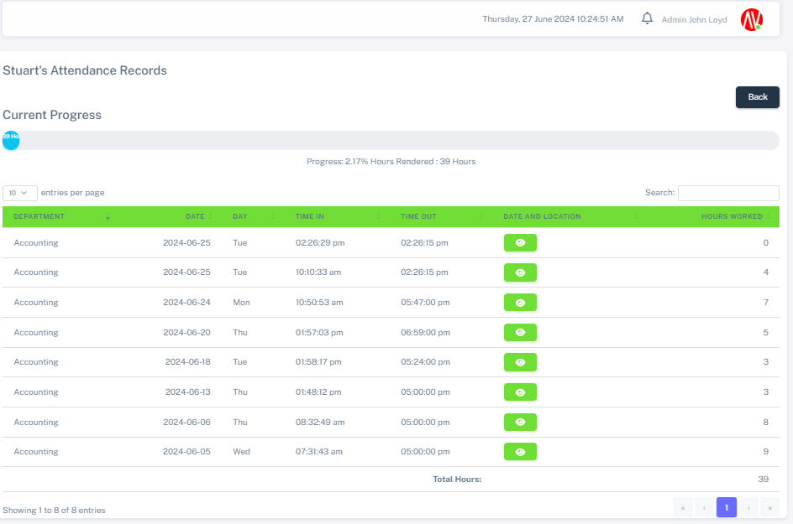
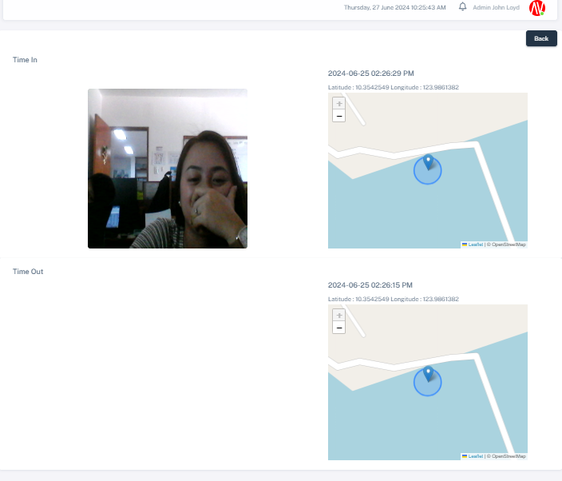
ATTENDANCE RECORDS
3. Display user’s attendance record and current progress.
3
4
4. Click the eye icon to view the user's location, time-in, and time-out details

Slide 39
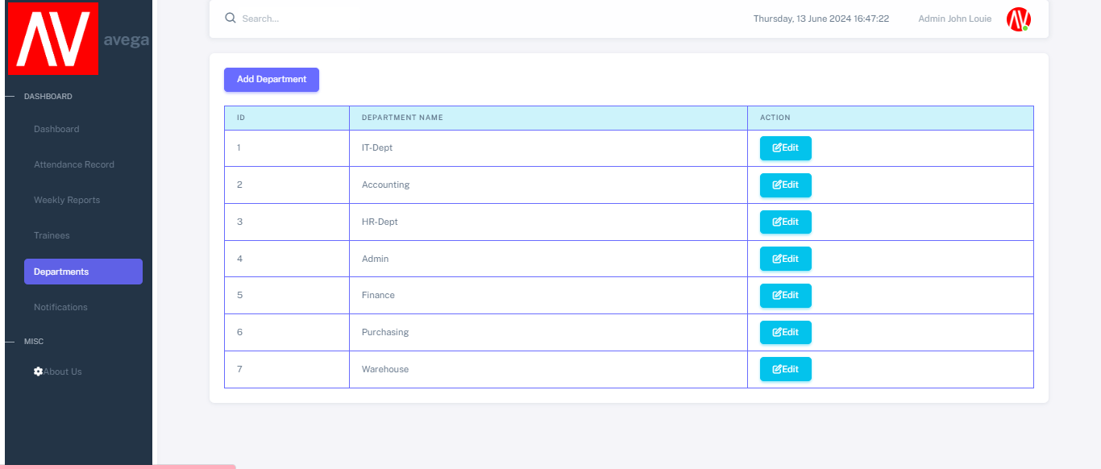
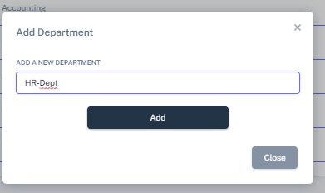
ADD DEPARTMENTS
1. Click Departments button to manage departments.
2
2. Click Add Departments to add new department
1
3
3.Type the Department name and click save.

Slide 40
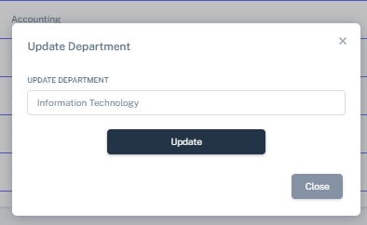
EDIT DEPARTMENTS
1. Click Departments button to manage departments.
2. Click Edit button to edit department.
2
3
1
3.Type the new Department name and click save.

Slide 41
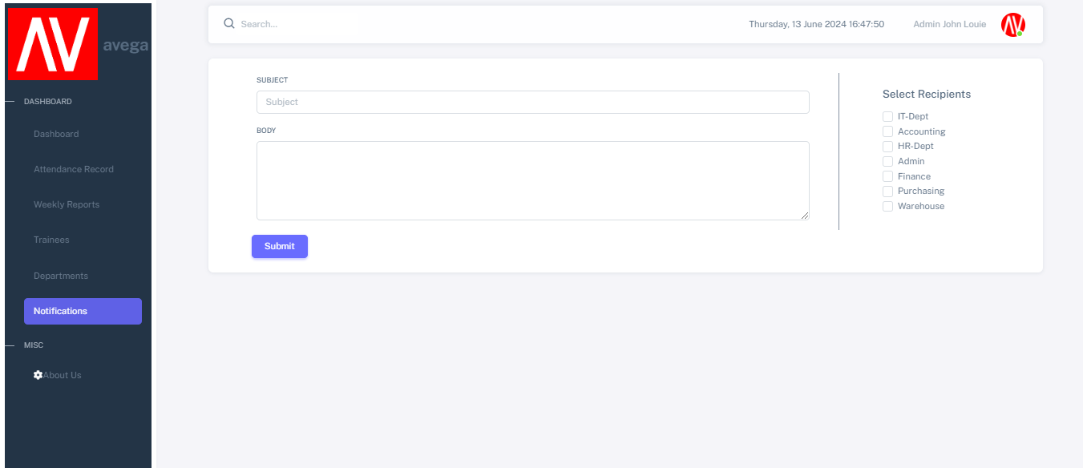
NOTIFICATION
1. Click Notifications.
2.Type the subject and body
3
2
4
1
3. Select the Departments you want the notifications to be sent.
4. Click submit button.

Slide 42
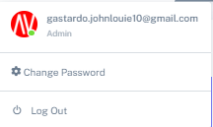
LOG OUT
1
2
1. Click Log Out if you want to log out your account.
2. Back to Log In page.

Slide 43
MANAGER PANEL
User’s Manual

Slide 44
LOGIN
Go to the Attendance Monitoring website.
http://localhost/av_ojt/project101/LOGIN/index.php
Enter your email address and password in the respective fields.
Click the Login button.
Click here to Login

Slide 45
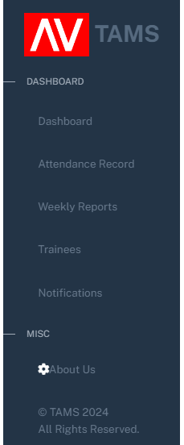
MANAGER NAVIGATION
Display the number of trainees and manage user accounts.
Monitor trainees attendance records.
Monitor the trainees weekly reports.
Manage trainees profiles.
Send notification alert to the users.
Developer credits.

Slide 46
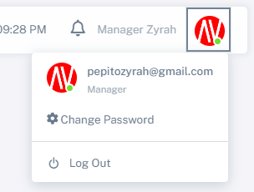
MANAGERS ACCOUNT
Displays your email and account type.
To update your password.
To securely exit your account.

Slide 47
CHANGE PASSWORD
1. Click Change Password if you want to change your password
2. Enter your current password, new password, and confirm password and click change button.
3. You will receive an email after changing your password
1
2
3

Slide 48
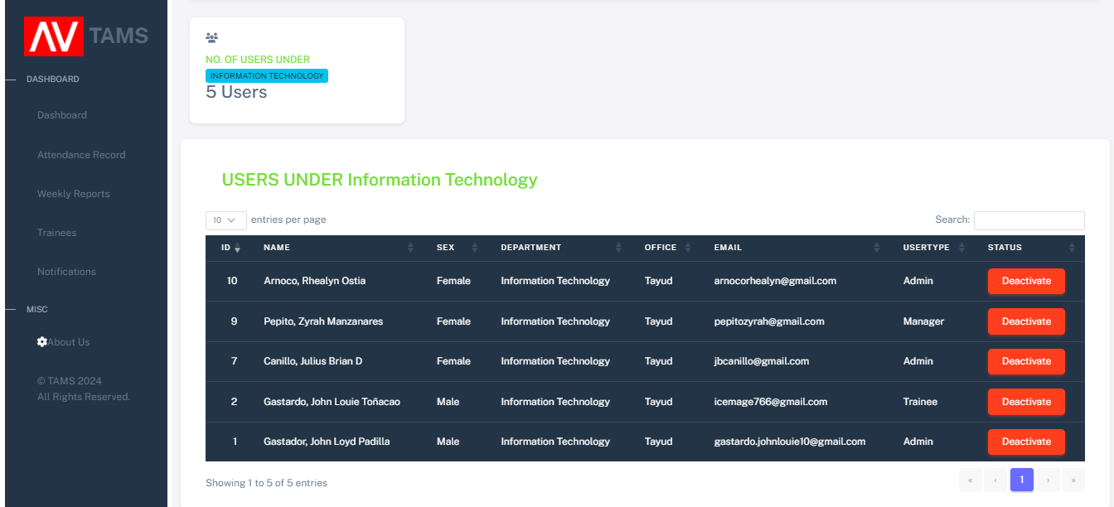
ACTIVATE AND DEACTIVATE ACCOUNTS
1.Click status to Activate or Deactivate user
1
2
2. Once the account is deactivated the user can’t login.

Slide 49

ATTENDANCE RECORD
1.Click attendance record to access details of trainee attendance.
2.Select filter to choose specific date and department.
2
1
If you wish to reset, click the reset button.

Slide 50
3.Select export to excel to generate the attendance report in excel format.
3
Here’s an example when exporting to Excel.

Slide 51
4.Select print current page to generate a printable report.
4
Here is an example you will see when you print the current page.

Slide 52

WEEKLY REPORTS
1. Click weekly reports button to view trainees responses.
1
2
2. Click view button to view the trainees responses

Slide 53
3. Click view button to view trainees response.
3
Trainee’s Response

Slide 54

TRAINEES PROFILE
2.Click here to view profile records
1.Click Trainees to manage and track progress.
2
1

Slide 55

3
3. Profile Information (View Only)
Here you could describe who this person is
Here you could describe who this person is

Slide 56
TRAINEES ATTENDANCE
1.Click Trainees to manage and track progress
2.Click here to view attendance records
1
2

Slide 57

ATTENDANCE RECORDS

Slide 58

NOTIFICATIONS
1. Click Notifications.
2.Type the subject and body
2
1
3
3. Click submit button.

Slide 59

DEVELOPER CREDITS

Slide 60

THANK YOU !!!!!!!

